Slide 1

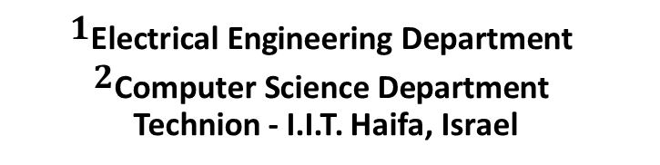
Introduction Motivation The Transitive Alg. Experiments Summary & Future Work
Transitive Re-identification
${\text{Yulia} \text{Brand}}^{1}$ ${ \text{Tamar} \text{Avraham}}^{2}$ ${\text{Michael} \text{Lindenbaum}}^{2}$
$$1_{\text{Electrical} \text{Engineering} \text{Department} }$$
$$2_{\text{Computer} \text{Science} \text{Department} }$$
Technion - I.I.T. Haifa, Israel
This research was supported by the MAGNET program in the Israeli ministry of industry
and commerce, by the Israeli ministry of science and by the E. and J. Bishop research fund.
BMVC 2013

Slide 2
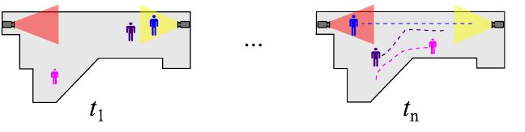
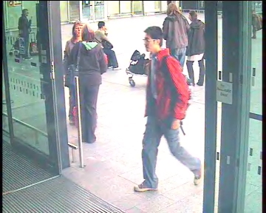
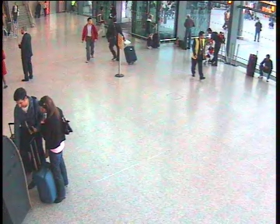
Introduction Motivation The Transitive Alg. Experiments Summary & Future Work
ReIDentification (ReID)
recognizing individuals over different camera views
(we focus on ReID based on appearance based cues)
Camera A, time t
Camera B, time t+∆t
upper image from: A. Bialkowski, S. Denman, P. Lucey, S. Sridharan, and C. B. Fookes. “A database for person re-identification in multi-camera surveillance networks.” (DICTA 2012)
lower images: courtesy of Marco Cristani
Notes:
The ReID problem has lately received increasing attention especially due to its important role in surveillance systems.
First, let’s define what ReID means.
Given a camera network covering non-overlapping fields of view on a site as for example an airport or a shopping mall,
we would want to be able to find correspondence between two appearances of the same subject captured in different location and time.
Thought ReID can use different kind of cues, in our work we focus on appearance based cues.

Slide 3
Introduction Motivation The Transitive Alg. Experiments Summary & Future Work
ReIDentification
Appearance-based ReIDentification methods:
Learning based methods:
do not depend on any training set
classification is based on pre-defined distance metric
Direct methods:
require a training set
classification is with a classifier or a metric learned on the training set
always camera-invariant
camera-invariant or camera-specific, depending on the used training set
perform better for “camera-specific” scenarios:
ReID benefits from training with corresponding appearance-pairs captured by specific camera
pairs, as the background, illumination, resolution and pose are camera dependent.
Notes:
This family can be divided into “learning based” methods and “direct” methods.
The “direct” methods do not have a training stage
And the classification in such methods is based on a pre-defined distance metric.
The “learning based” methods require a training set consisting of pairs of annotated tracks of a subject, captured by different cameras.
These annotated examples are used to learn the transfer domain and to either train a classifier or learn a metric that would suggest a ‘same’/‘not same’ classification or would provide a score for the likelihood of a match.
“direct” methods are always “camera invariant”, and aim at re-identifying a person at any new location.
While the “learning based” methods can be either “camera-invariant” or “camera-specific”, depending on the used training set.
It was shown that the learning based methods perform better for “camera specific” scenarios.
It actually makes sense that ReID benefits from training with corresponding appearance-pairs captured by specific cameras pairs, as the background, illumination, resolution and pose are camera dependent.

Slide 4
Introduction Motivation The Transitive Alg. Experiments Summary & Future Work
ReIDentification
Learning based methods perform better for “camera-specific” scenarios:
ICT – learning based
SDALF - direct
ICT (Implicit Camera Transfer) by Avraham et al (ECCV Re-Id 2012)
SDALF (Symmetry-Driven Accumulation of Local Features) by Farenzena et al (CVPR 2010) and Bazzani et al (CVIU 2013)
performance tested on 2 cameras from the SAIVT-SoftBio dataset
Notes:
To demonstrate this observation, I shall describe here the results comparing the performance of one learning based “camera specific” method and one direct method.
The results are compared using CMC curves. These curves are the most widely used tool for evaluation of ReID algorithms, so I'll take a minute to explain them.
For each subject in the test set, the evaluated algorithm ranks the matching of his appearance to all other subjects in the test set.
The CMC curve summarizes the rank statistics of the true matches.
These CMCs compare the performance of a state of the art, learning based ICT, trained on data from two specific cameras, to a state of the art direct representative method SDALF.
The learning based ICT clearly outperforms.

Slide 5
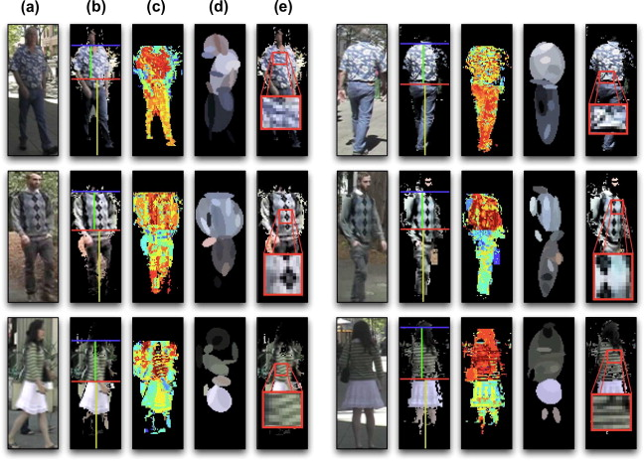


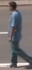
Introduction Motivation The Transitive Alg. Experiments Summary & Future Work
ReIDentification
Learning method: ICT
Direct method: SDALF
  Image A
  (a)
  (b)
  (c)
  (d)
Camera A
F
same
C
  Image B
Camera B
not same
F
(a) localizing meaningful body parts
(b) weighted HSV histogram
(c) MSCR - maximally stable color regions
  Binary SVM with
  RBF kernel, using
  Decision values
(d) RHSP - recurrent highly structured patches
=> matching SDALF descriptors
* Image from: L. Bazzani, M. Cristani, and V. Murino. Symmetry-driven accumulation of local features for human characterization and re-identification.
Notes:
Now let’s take a minute just to give a quick overview of these two methods.
In the learning based ICT algorithm,
Given 2 subjects appearances captures by cameras A and B, the 2 images go through a features extraction stage in which a feature vector is created for each.
Pairs of FVs are concatenated creating “positive” pairs when both FVs belong to the same subject and “negative” pairs when each FV belongs to a different subject.
All concatenated FVs are fed into a learning classifier outputting a ‘same’/’not same’ decision.
The FVs used here are HSV histograms extracted from 5 horizontal stripes of the image.
And the classifier is a binary SVM with an RBF kernel outputting decision values.
In the direct SDALF, given 2 subjects appearances in any 2 locations,
The first stage is the localization of meaningful body part exploiting symmetry and asymmetry of the body.
Then weighted HSV histograms are extracted from each part, followed by the extraction of maximally stable color regions (MSCR) and recurrent highly structured patches (RHSP).
Matching of the SDALF descriptors gives the similarity measure between the candidates.

Slide 6












Introduction Motivation The Transitive Alg. Experiments Summary & Future Work
Motivation
Given a site with $N$cameras $C_{1},C_{2},…C_{N}$ , we may ReID either by:
applying a direct method
2. applying a learning based method where distinct inter-camera training sets must be collected and annotated for each camera-pair. This is impractical.
$$C_{1}$$
$$C_{1}$$
$$C_{N}$$
$$C_{2}$$
$$C_{N}$$
$$C_{2}$$
$$C_{5}$$
$$C_{3}$$
$$C_{5}$$
$$C_{3}$$
$$C_{4}$$
$$C_{4}$$
Notes:
The motivation to our work arises when working with more than two cameras.
Suppose we want to do ReID in a site with N cameras,
we may either perform ReID just by applying a direct method, which is less accurate
Or
We may apply a learning based method but then, distinct inter-camera training sets must be collected and annotated for each camera-pair.
Such a requirement may be very computationally expensive and impractical for real life applications.
In our work, we aim at reducing the number of the required direct inter-camera training sets from $O(N^{2})$ – the order of N square while preserving the superior performance of the learning based approach.

Slide 7








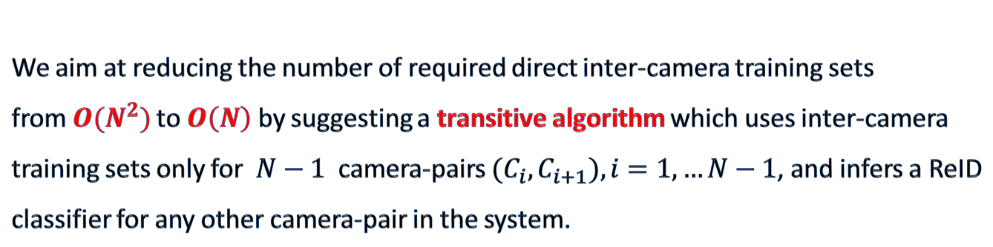






Introduction Motivation The Transitive Alg. Experiments Summary & Future Work
Motivation
We aim at reducing the number of required direct inter-camera training sets
from $O(N^{2})$to $O\left(N\right)$ by suggesting a transitive algorithm which uses inter-camera training sets only for $N−1$ camera-pairs ${(C}_{i},C_{i+1}),i=1,…N−1$, and infers a ReID classifier for any other camera-pair in the system.
By applying the
transitive algorithm:
By recursively applying the transitive algorithm:
$$C_{1}$$
$$C_{1}$$
$$C_{1}$$
$$C_{N}$$
$$C_{2}$$
$$C_{N}$$
$$C_{2}$$
$$C_{N}$$
$$C_{2}$$
$$C_{5}$$
$$C_{3}$$
$$C_{5}$$
$$C_{3}$$
$$C_{5}$$
$$C_{3}$$
$$C_{4}$$
$$C_{4}$$
$$C_{4}$$
directly trainable pairs
non-directly trainable pairs
Notes:
We present a transitive algorithm which uses inter-camera training sets only for N-1 camera-pairs, but still performs better than the direct methods.
These N-1 camera pairs are referred to as “directly trainable pairs”.
Given the training sets associated for example with the camera pairs [C1 C2] and [C2 C3] the transitive algorithm infers a ReID classifier for [C1 C3].
Similarly, all “double step” classifiers can be inferred for such “non directly trainable pairs”
Then, by recursively applying the transitive algorithm, the inter-camera classifiers for any other camera pair in the system can be deduced.
In this way we are significantly minimizing the number of the required direct inter-camera training sets from $N$ square to $N$.

Slide 8

Introduction Motivation The Transitive Alg. Experiments Summary & Future Work
Motivation
When a new camera is added to a set of N previously installed cameras,
with the proposed transitive approach, collecting data for only one pair is
required.
$$C_{1}$$
$$C_{N}$$
$$C_{2}$$
$$C_{5}$$
$$C_{3}$$
$$C_{4}$$
$$C_{N+1}$$
Notes:
Another advantage arises when a new camera is added, since then collecting data for only one pair is required.

Slide 9
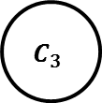
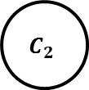
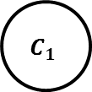
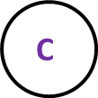


Introduction Motivation The Transitive Alg. Experiments Summary & Future Work
The Transitive Algorithm
We focus on a camera triplet case $\left[A B C\right]$.
$$C_{1}$$
$$C_{1}$$
$$\text{A}$$
$$C_{N}$$
$$C_{2}$$
$$C_{2}$$
$$\text{B}$$
$$C_{5}$$
$$C_{3}$$
$$C_{4}$$
$$C_{3}$$
$$\text{C}$$
Notes:
We will now focus on a camera triplet case out of the system.
For convenience, from now, we will denote the three cameras [A B C].

Slide 10
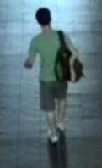

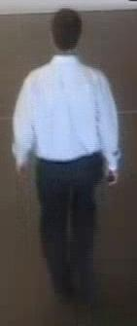
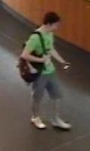
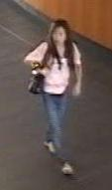
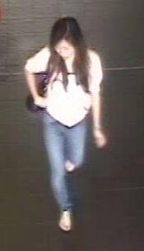
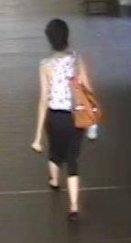

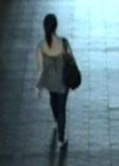
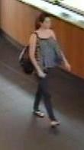

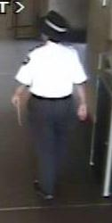

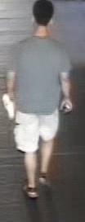
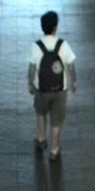
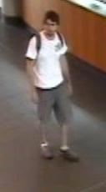
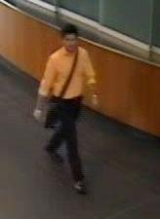

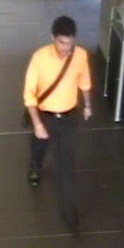
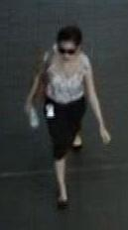
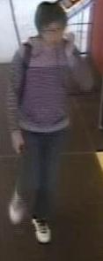
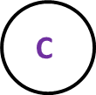




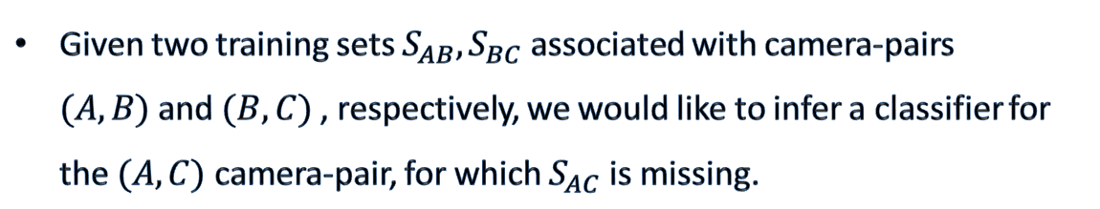
Introduction Motivation The Transitive Alg. Experiments Summary & Future Work
The Transitive Algorithm
$$\text{A}$$
$$S_{AB}$$
$$\text{B}$$
Given two training sets $S_{AB},S_{BC}$ associated with camera-pairs $(A,B)$and $(B,C)$, respectively, we would like to infer a classifier for the $(A,C)$camera-pair, for which $S_{AC}$ is missing.
$$S_{BC}$$
$$\text{C}$$
Training
Test
A
B
B
C
A
C
= ?
= ?
= ?
Notes:
So, we will address the following scenario: given an annotated training set of matched appearances across the cameras [A B] and another training set for the camera pair [B C], both denoted $S_{AB},S_{BC}$ respectively, our goal would be to infer a classifier for the [A C] cameras where no such training set is available.
The remaining of this talk is about how to do that?

Slide 11
Introduction Motivation The Transitive Alg. Experiments Summary & Future Work
The Transitive Algorithm
$$\text{A}$$
$$\text{B}$$
Expanding the learning based method – the Naive solution:
training the $(A,C)$ classifier with $S_{AB}{∪S}_{BC}$
ICT
$$\text{C}$$
SDALF
Naive ICT
Our goal is to find a more effective use of the available training sets that will decrease this performance gap.
Notes:
The first most intuitive and somehow “naive” would be to use the union of the available training sets.
The CMC graph presented here, is actually the same graph we saw before, now added with the red CMC, showing the performance of ICT trained with the union of the [A B] and [B C] training sets.
The green CMC presents the performance of the ICT when [A C] are a directly trainable pair.
There clearly is a significant performance gap between the red and the green CMCs.
Our goal would be to find a more effective use of the available training sets, such that will aim on minimizing this performance gap, getting as close as possible to the green CMC.

Slide 12
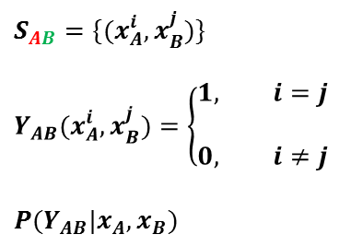

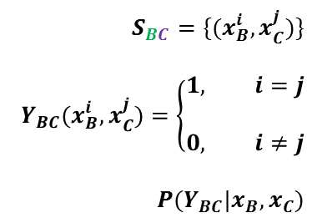
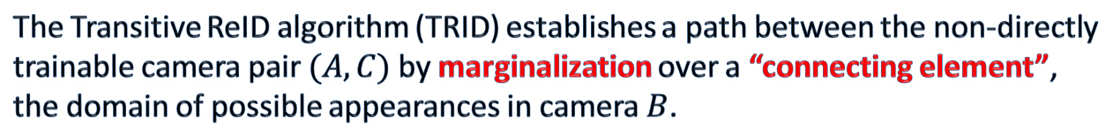
Introduction Motivation The Transitive Alg. Experiments Summary & Future Work
The Transitive Algorithm
$$\text{A}$$
$$S_{AB}$$
$$\text{B}$$
$$S_{AB}=\{(x_{A}^{i},x_{B}^{j})\}$$
$$Y_{AB}(x_{A}^{i},x_{B}^{j})=\left\{\begin{aligned}1, i=j \\ \\ 0, i≠j\end{aligned}\right.$$
$$P(Y_{AB}|x_{A},x_{B})$$
$$S_{BC}=\{(x_{B}^{i},x_{C}^{j})\}$$
$$Y_{BC}(x_{B}^{i},x_{C}^{j})=\left\{\begin{aligned}1, i=j \\ \\ 0, i≠j\end{aligned}\right.$$
$$P(Y_{BC}|x_{B},x_{C})$$
$$S_{BC}$$
$$\text{C}$$
$$P\left(Y_{AC} | x_{A},x_{C}\right)=?$$
The Transitive ReID algorithm (TRID) establishes a path between the non-directly trainable camera pair $(A,C)$by marginalization over a “connecting element”, the domain of possible appearances in camera $B$.
$$P\left(Y_{AC} | x_{A},x_{C}\right)=\sum_{y_{AB}∈\{0,1\}}{ \sum_{y_{BC}∈\{0,1\}}{ \int_{x_{B}∈R^{d}}^{ }{P\left(Y_{AC}, Y_{AB}=y_{AB},Y_{BC}=y_{BC}, x_{B} \right|}x_{A},x_{C})ⅆx_{B}}}$$
$$P\left(Y_{AC} | x_{A},x_{C}\right)=\sum_{y_{AB}∈\{0,1\}}{ \sum_{y_{BC}∈\{0,1\}}{\left[\int_{x_{B}∈R^{d}}^{ }{P\left(Y_{AC}, Y_{AB}=y_{AB},Y_{BC}=y_{BC}\right|}x_{A},{x_{B} ,x}_{C})f_{x_{B}}(x_{B})ⅆx_{B}\right]}}$$
Notes:
We present here a “probabilistic transitive” algorithm.
So, as already mentioned, we have the training sets for cameras [A B] and [B C].
The notation $x_{A}^{i}$, for example, refers to a multi-dimensional feature vector describing the appearance of a subject of the identity i, observed by camera A.
For the [A B] camera pair, we use a binary variable $Y_{AB}$ to model the probability that the two appearances captured by cameras A and B correspond to the same person. => $P(Y_{AB}|x_{A},x_{B})$.
$Y_{AB}$ gets the value 1 if and only if the appearances given in both cameras belong to the same identity.
The same goes for the [B C] camera pair.
Given the two conditional probabilities, our goal is to estimate such conditional probability for the (A C) camera pair, given the appearances captured by cameras A and C =>$P\left(Y_{AC} | x_{A},x_{C}\right)$, although a training set consisting of annotated pairs [A C] is not available.
The Transitive algorithm (TRID) establishes a path between the non-directly trainable pair (A,C) by marginalization over a “connecting element” of these two conditional probabilities which is $x_{B}$, the domain of possible appearances in camera $B$.
To obtain this conditional probability $P\left(Y_{AC} | x_{A},x_{C}\right)$ we first marginalize over all possible values of $Y_{AB}$,$Y_{BC}$ and $x_{B}$
By applying the chain rule we get the following expression….

Slide 13
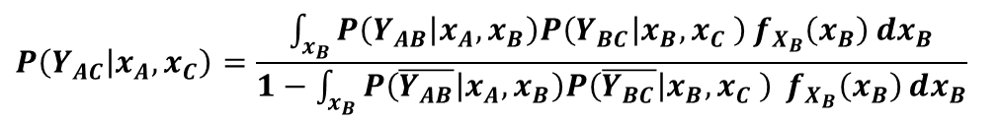
Introduction Motivation The Transitive Alg. Experiments Summary & Future Work
The Transitive Algorithm
$$\text{A}$$
$$\text{B}$$
$$S_{AB}=\{(x_{A}^{i},x_{B}^{j})\}$$
$$Y_{AB}(x_{A}^{i},x_{B}^{j})=\left\{\begin{aligned}1, i=j \\ \\ 0, i≠j\end{aligned}\right.$$
$$P(Y_{AB}|x_{A},x_{B})$$
$$S_{BC}=\{(x_{B}^{i},x_{C}^{j})\}$$
$$Y_{BC}(x_{B}^{i},x_{C}^{j})=\left\{\begin{aligned}1, i=j \\ \\ 0, i≠j\end{aligned}\right.$$
$$P(Y_{BC}|x_{B},x_{C})$$
$$\text{C}$$
$$P\left(Y_{AC} | x_{A},x_{C}\right)=?$$
The Transitive ReID algorithm (TRID) establishes a path between the non-directly trainable camera pair $(A,C)$by marginalization over a “connecting element”, the domain of possible appearances in camera $B$.
.
.
.
.
$$P\left(Y_{AC} | x_{A}, x_{C}\right)=\frac{\int_{x_{B}}^{ }{P\left(Y_{AB} | x_{A}, x_{B}\right)P\left(Y_{BC} | x_{B}, x_{C} \right)}f_{X_{B}}\left(x_{B}\right)ⅆx_{B}}{1−\int_{x_{B}}^{ }{P\left(\overline{Y_{AB}} | x_{A}, x_{B}\right)P\left(\overline{Y_{BC}} | x_{B}, x_{C} \right)} f_{X_{B}}\left(x_{B}\right)ⅆx_{B}}$$
Notes:
After several more steps of applying some probability rules and by a simple reorganization, the desired conditional probability is expressed by the following formula.
Of course, the full derivation of the formula can be found in the paper.

Slide 14
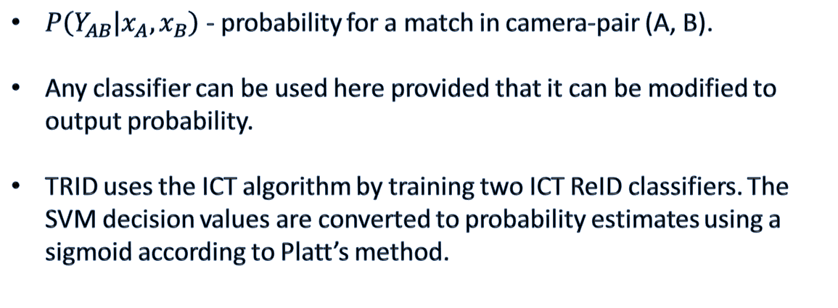
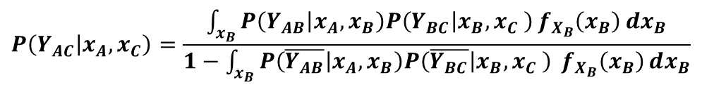
Introduction Motivation The Transitive Alg. Experiments Summary & Future Work
The Transitive Algorithm
$$\text{A}$$
$$\text{B}$$
$$P\left(Y_{AC} | x_{A}, x_{C}\right)=\frac{\int_{x_{B}}^{ }{P\left(Y_{AB} | x_{A}, x_{B}\right)P\left(Y_{BC} | x_{B}, x_{C} \right)}f_{X_{B}}\left(x_{B}\right)ⅆx_{B}}{1−\int_{x_{B}}^{ }{P\left(\overline{Y_{AB}} | x_{A}, x_{B}\right)P\left(\overline{Y_{BC}} | x_{B}, x_{C} \right)} f_{X_{B}}\left(x_{B}\right)ⅆx_{B}}$$
$$\text{C}$$
ICT [A B]
ICT [B C]
$P\left(Y_{AB} | x_{A}, x_{B}\right)$ - probability for a match in camera-pair (A, B).
Any classifier can be used here provided that it can be modified to output probability.
TRID uses the ICT algorithm by training two ICT ReID classifiers. The SVM decision values are converted to probability estimates using a sigmoid according to Platt’s method.
Notes:
Now, let’s take a closer look at this expression.
The term $P(Y_{AB}|x_{A},x_{B})$ is the probability for a match in the camera-pair [A B].
Any classifier can be used here, provided that it can be modified to output a probability.
We are using here the ICT, once for [A B] and once for [B C].
It outputs decision values which are actually SVM decision values.
These are converted to probability estimates using a sigmoid according to Platt’s method.

Slide 15
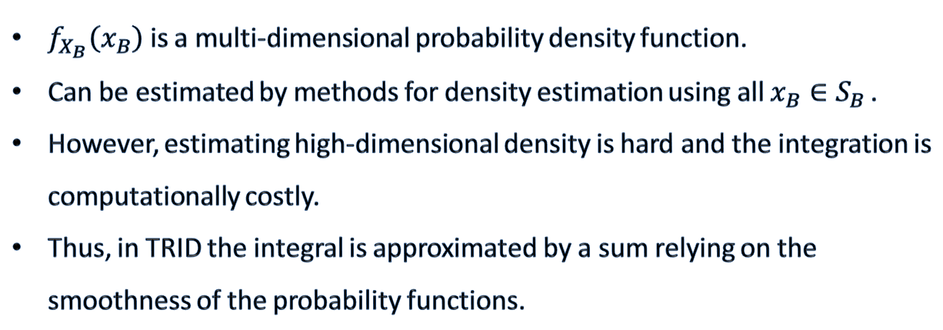
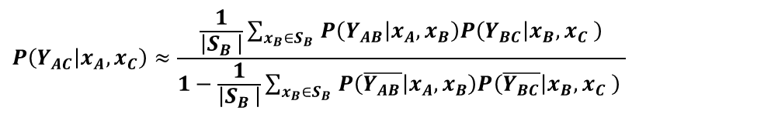
Introduction Motivation The Transitive Alg. Experiments Summary & Future Work
The Transitive Algorithm
$$\text{A}$$
$$\text{B}$$
$$P\left(Y_{AC} | x_{A}, x_{C}\right)=\frac{\int_{x_{B}}^{ }{P\left(Y_{AB} | x_{A}, x_{B}\right)P\left(Y_{BC} | x_{B}, x_{C} \right)}f_{X_{B}}\left(x_{B}\right)ⅆx_{B}}{1−\int_{x_{B}}^{ }{P\left(\overline{Y_{AB}} | x_{A}, x_{B}\right)P\left(\overline{Y_{BC}} | x_{B}, x_{C} \right)} f_{X_{B}}\left(x_{B}\right)ⅆx_{B}}$$
$$\text{C}$$
$f_{X_{B}}\left(x_{B}\right)$ is a multi-dimensional probability density function.
Can be estimated by methods for density estimation using all $x_{B}∈S_{B }$.
However, estimating high-dimensional density is hard and the integration is computationally costly.
Thus, in TRID the integral is approximated by a sum relying on the smoothness of the probability functions.
$$P\left(Y_{AC} | x_{A}, x_{C}\right)≈\frac{\frac{1}{\left|S_{B }\right|}\sum_{x_{B}∈S_{B }}{P\left(Y_{AB} | x_{A}, x_{B}\right)P\left(Y_{BC} | x_{B}, x_{C} \right)}}{1−\frac{1}{\left|S_{B }\right|}\sum_{x_{B}∈S_{B }}{P\left(\overline{Y_{AB}} | x_{A}, x_{B}\right)P\left(\overline{Y_{BC}} | x_{B}, x_{C} \right)} }$$
Notes:
The $f\left(x_{B}\right)$ term is a multi-dimensional probability density function
It can be estimated by different methods for density estimation using:
the $x_{B}$ vectors available from the training sets of the camera pairs (A, B) and (B,C) and also other, non-annotated, appearances/instances associated with people passing in front of camera B.
However, estimating high-dimensional density is hard and such integration is computationally costly.
Therefore, the proposed TRID algorithm approximates the integral by a sum over all available $x_{B}$ vectors. We are relying on the smoothness of the probability functions to make the sum a good approximation of the integral as we will now show in our experiments.

Slide 16












Introduction Motivation The Transitive Alg. Experiments Summary & Future Work
Synthetic Experiment 1
$$\text{A}$$
$$x_{A}×x_{B}$$
$$x_{B}×x_{C}$$
$$x_{A}×x_{C}$$
$$\text{B}$$
$$\text{C}$$
$$x_{A}×x_{C}$$
$$x_{A}×x_{C}$$
$$x_{A}×x_{C}$$
$$P\left(Y_{AC} | x_{A}, x_{C}\right):$$
$$Naive ICT$$
$$ICT trained on AC data$$
$$TRID$$
Notes:
To get some intuitive understanding first, we started our experiments using simple low dimensional synthetic data, where $x_{A},x_{B},x_{C}$ are all one dimensional feature vectors.
This set up was chosen so that we could illustrate.
The data here is generated as follows: $x_{A}$ values are randomly sampled from a uniform distribution, then $x_{B}$ and $x_{C}$ are created by simple linear functions. $x_{B}$ as a function of $x_{A}$ and $x_{C}$ as a function of $x_{A}$. All are added with some Gaussian noise.
So, clearly the relation between feature points $x_{C}$ and their corresponding points $x_{A}$ is also given by a linear function
The CMC curve shows the ReID results. I am reminding you that the green CMC is always used as a reference to the upper bound of the expected performance since it is achieved when a learning based ICT is trained on the [A C] camera pair training set.
We see that the transitive TRID is only slightly outperformed by the green CMC (or: is almost as good as the green CMC).
Note that the naive algorithm fails to learn the true transformation.
The $P\left(Y_{AC} | x_{A},x_{C}\right)$ function that was learned by each of the three is plotted in the bottom row.
The upper right corner shows the true function.
The TRID and the ICT were able to learn the correct relation between A and C while the Naïve ICT did not.

Slide 17



Introduction Motivation The Transitive Alg. Experiments Summary & Future Work
Synthetic Experiment 2
$$\text{A}$$
$$x_{A}×x_{B}$$
$$x_{B}×x_{C}$$
$$x_{A}×x_{C}$$
$$\text{B}$$
$$\text{C}$$
$$x_{A}×x_{C}$$
$$x_{A}×x_{C}$$
$$x_{A}×x_{C}$$
$$P\left(Y_{AC} | x_{A}, x_{C}\right):$$
$$Naive ICT$$
$$ICT trained on AC data$$
$$TRID$$
Notes:
The same holds for more complex inter-camera relations.
Our method can learn it accurately also here.

Slide 18
Introduction Motivation The Transitive Alg. Experiments Summary & Future Work
SAIVT-SoftBio Experiment
Testing TRID requires an annotated dataset associated with at least 3 stationary cameras.
Common ReID benchmark datasets (VIPeR , CAVIAR4REID, iLIDs MCTS, ETHZ) are unsuitable for our set-up.
Multi-camera surveillance database named SAIVT-SoftBio presented by Bialkowski et al:
image from: A. Bialkowski, S. Denman, P. Lucey, S. Sridharan, and C. B. Fookes. “A database for person re-identification in multi-camera surveillance networks.” (DICTA 2012)
Notes:
Next we moved on to a multi-camera setup.
To test the TRID algorithm, we needed an annotated dataset associated with a site with at least 3 stationary cameras and for that we used the recently presented multi-camera surveillance database named SAIVT-SoftBio.
It includes annotated sequences, each captured by a subset of eight different indoor cameras, providing various viewing angles and varying illumination conditions.
Here is the approximate camera placement and orientation.

Slide 19
Introduction Motivation The Transitive Alg. Experiments Summary & Future Work
SAIVT-SoftBio Experiment
[A B C] =
C3
C5
C7
[A B C] =
C1
C5
C7
[A B C] =
C1
C5
C3
[A B C] =
C1
C3
C8
Notes:
We performed four transitive ReID experiments and here we present their results.
In each experiment a different camera triplet played the role of cameras A, B and C representing a variety of possible inter-camera relations.
The four selected triplets were those that included the largest number of commonly annotated subjects.
Again, the green CMC simulates the performance of the best classifier obtained with a learning based method when an annotated training set for cameras [A C] is available for training.
Reminding you that the motivation behind the development of the TRID was to get close as possible to that performance when no such training data is available by transitively using the training sets for cameras [A B] and [B C].
We compared the TRID results to results obtained by:
- the Naive transitive approach we discussed, which is training the ReID classifier with the union of the [A B] and [B C] training sets and to, given by the red CMC
- the results of the direct SDALF method, given in dashed black over the same test set.
The CMC curve for the TRID is given in black.
Overall, the results show that TRID performed better than the direct method and with notably improved performance over the Naive ICT method.
The most significant performance gap reduction occurred for the triplet at the upper left corner where TRID performed almost as well as the reference ICT trained on AC data.
Let’s take a closer look at this case.

Slide 20
Introduction Motivation The Transitive Alg. Experiments Summary & Future Work
SAIVT-SoftBio Experiment
[A B C] =
C3
C5
C7
B
C
A
Notes:
Here, the cameras playing the roles of A and C were located far away from each other and associated with significantly different appearances due to different illumination conditions and background.
The camera playing the role of B, was located just in the middle, and seems to provide a good and informative transitive path.

Slide 21
Introduction Motivation The Transitive Alg. Experiments Summary & Future Work
SAIVT-SoftBio Experiment
[A B C] =
C3
C5
C7
[A B C] =
C1
C5
C7
[A B C] =
C1
C5
C3
[A B C] =
C1
C3
C8
Notes:
Let’s take a look now at a case where the advantage of the TRID is smaller. For example, for the camera triplet on the lower right corner.

Slide 22
Introduction Motivation The Transitive Alg. Experiments Summary & Future Work
SAIVT-SoftBio Experiment
A
C
B
[A B C] =
C1
C3
C8
Notes:
It seems that when either the A,B or the B,C views are similar, as here the view of cameras B and C are similar, the performance of TRID is similar to the performance of the Naive approach probably since such a path is not an informative transitive path for this camera pair.

Slide 23
Introduction Motivation The Transitive Alg. Experiments Summary & Future Work
Summary
When performing ReID in multi-camera site, we do not have to choose between the less accurate direct method and the computationally expensive learning based method.
We may perform limited learning, such that requires reasonable resources.
We have shown that transitively using such learning performs well for the ReID task.
A specific algorithm based on marginalization was suggested: the TRID - which presents a new approach of transitivity in ReID.
The accuracy of the TRID is superior to that of a state-of-the-art non learning based approach.
The TRID algorithm is in fact a general framework that may be combined with different probabilistic classifiers (not necessarily ICT) and of course different features.
Notes:
So to summarize,
In this work, we suggest the observation that when performing ReID in multiple camera site, we no longer have to choose between the less accurate direct method and the computationally expensive learning based method, but we can also choose a third way. We may perform limited learning, such that requires reasonable resources. We have shown that transitively using such learning gives good ReID performance.
In particular, we suggested a specific algorithm based on marginalization: the TRID algorithm , which presents a new approach of transitivity in ReID.
We have shown that its accuracy is superior to that of a state-of-the-art non learning based approach.
The presented algorithm is in fact a general framework that may be combined with different probabilistic classifiers, not necessarily ICT, and of course with different features.

Slide 24




Introduction Motivation The Transitive Alg. Experiments Summary & Future Work
Future Work
Improve the approximation of the transitive integral.
Transitively use indirect training sets to strengthen direct learning when the set of direct annotated pairs is small, but not empty.
Test the effect of recursively applying the TRID algorithm, and to study the deterioration of the performance as a function of the number of cameras.
Generalize the TRID algorithm beyond the scope of ReID to other domain adaptation tasks.
$$C_{1}$$
$$C_{2}$$
$$C_{3}$$
$$C_{4}$$
Notes:
We intend to continue working in this direction and looking for other ways to approximate the transitive integral.
Another goal would be to find a way to transitively use of the indirect training sets to strengthen direct learning when the set of direct annotated pairs is small, but not empty.
We plan to test the effect of recursively applying the TRID algorithm, and to study the deterioration of the performance as a function of the number of cameras.
We also intend to work on the generalization of the TRID algorithm beyond the scope of ReID to other domain adaptation tasks.

Slide 25
Introduction Motivation The Transitive Alg. Experiments Summary & Future Work
Thank-You.
The Matlab source code of TRID as well as of the ICT are available at:
http://www.cs.technion.ac.il/~tammya/Reidentification.html .

